Slide 1
Recurrent Neural Networks
Dr. Nisha Varghese

Slide 2
Introduction
Recurrent Neural Networks (RNNs) are a type of artificial neural network designed to process sequences of data.
RNN works on the principle of saving the output of a particular layer and feeding this back to the input in order to predict the output of the layer.
They work especially well for jobs requiring sequences, such as time series data, voice, natural language, and other activities.

Slide 3
Feed forward Networks
Cannot handle previous data
Based on given input
Cannot memorize the previous data

Slide 4
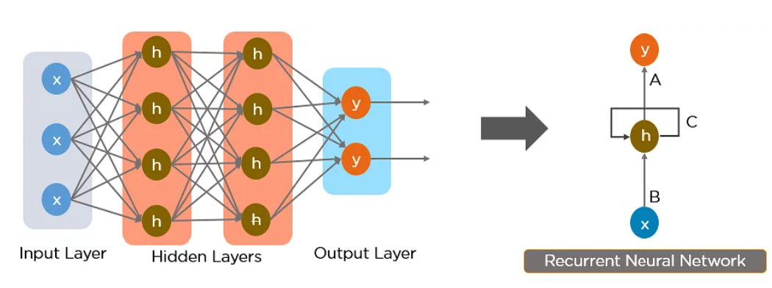
Architecture of RNN
The nodes in different layers of the neural network are compressed to form a single layer of recurrent neural networks. A, B, and C are the parameters of the network.

Slide 5
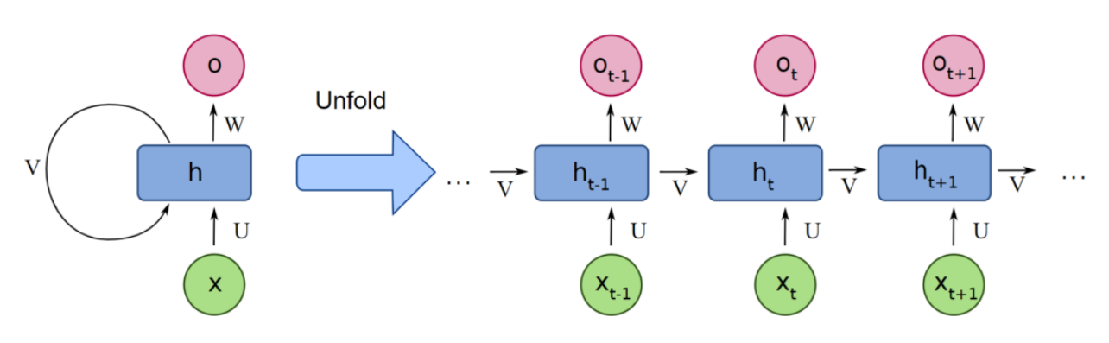

Slide 6

The information in recurrent neural networks cycles through a loop to the middle hidden layer. The input layer x receives and processes the neural network’s input before passing it on to the middle layer.

Slide 7
Multiple hidden layers can be found in the middle layer h, each with its own activation functions, weights, and biases.
RNN can be utilized, if the various parameters of different hidden layers are not impacted by the preceding layer, i.e. There is no memory in the neural network.
The different activation functions, weights, and biases will be standardized by the Recurrent Neural Network, ensuring that each hidden layer has the same characteristics.
Rather than constructing numerous hidden layers, it will create only one and loop over it as many times as necessary.

Slide 8
Types of Recurrent Neural Networks
Feedforward networks have single input and output, while recurrent neural networks are flexible as the length of inputs and outputs can be changed.
This flexibility allows RNNs to generate music, sentiment classification, and machine translation.

Slide 9
Advantages of Recurrent Neural Network
Recurrent Neural Networks (RNNs) have several advantages over other types of neural networks, including:
Ability To Handle Variable-Length Sequences - RNNs are designed to handle input sequences of variable length, which makes them well-suited for tasks such as speech recognition, natural language processing, and time series analysis.
Memory Of Past Inputs - RNNs have a memory of past inputs, which allows them to capture information about the context of the input sequence. This makes them useful for tasks such as language modeling, where the meaning of a word depends on the context in which it appears.
Parameter Sharing - RNNs share the same set of parameters across all time steps, which reduces the number of parameters that need to be learned and can lead to better generalization.

Slide 10
Non-Linear Mapping - RNNs use non-linear activation functions, which allows them to learn complex, non-linear mappings between inputs and outputs.
Sequential Processing - RNNs process input sequences sequentially, which makes them computationally efficient and easy to parallelize.
Flexibility - RNNs can be adapted to a wide range of tasks and input types, including text, speech, and image sequences.
Improved Accuracy - RNNs have been shown to achieve state-of-the-art performance on a variety of sequence modeling tasks, including language modeling, speech recognition, and machine translation.
These advantages make RNNs a powerful tool for sequence modeling and analysis, and have led to their widespread use in a variety of applications, including natural language processing, speech recognition, and time series analysis.

Slide 11
Disadvantages of Recurrent Neural Network
Vanishing And Exploding Gradients - RNNs can suffer from the problem of vanishing or exploding gradients, which can make it difficult to train the network effectively. This occurs when the gradients of the loss function with respect to the parameters become very small or very large as they propagate through time.
Computational Complexity - RNNs can be computationally expensive to train, especially when dealing with long sequences. This is because the network has to process each input in sequence, which can be slow.
Difficulty In Capturing Long-Term Dependencies - Although RNNs are designed to capture information about past inputs, they can struggle to capture long-term dependencies in the input sequence. This is because the gradients can become very small as they propagate through time, which can cause the network to forget important information.

Slide 12
Lack Of Parallelism - RNNs are inherently sequential, which makes it difficult to parallelize the computation. This can limit the speed and scalability of the network.
Difficulty In Choosing The Right Architecture - There are many different variants of RNNs, each with its own advantages and disadvantages. Choosing the right architecture for a given task can be challenging, and may require extensive experimentation and tuning.
Difficulty In Interpreting The Output - The output of an RNN can be difficult to interpret, especially when dealing with complex inputs such as natural language or audio. This can make it difficult to understand how the network is making its predictions.

Slide 13
Types of Recurrent Neural Networks
There are four types of Recurrent Neural Networks:
One to One
One to Many
Many to One
Many to Many

Slide 14
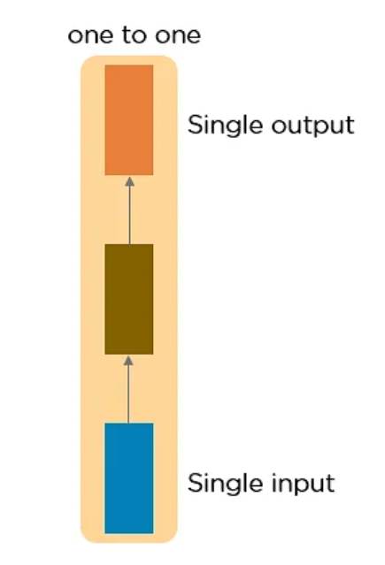
One to One RNN
One to One type of neural network is known as the Vanilla Neural Network.
It's used for general machine learning problems, which has a single input and a single output.

Slide 15
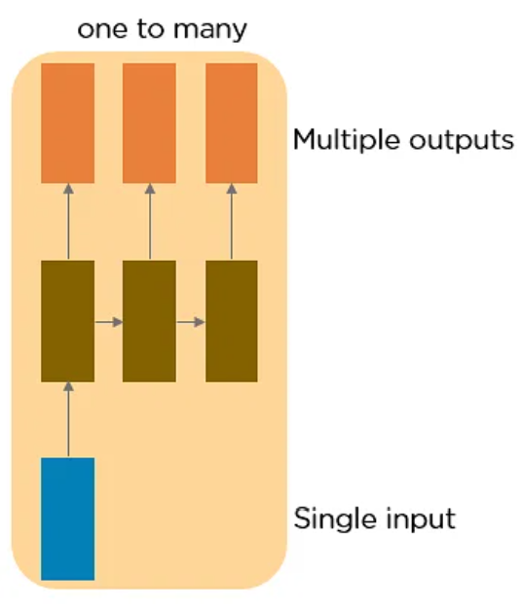
One to Many RNN
One to Many type of neural network has a single input and multiple outputs.

Slide 16
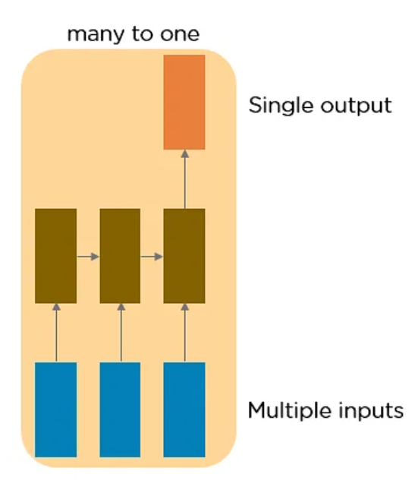
Many to One
Many to One RNN takes a sequence of inputs and generates a single output.
Sentiment analysis is a good example of this kind of network where a given sentence can be classified as expressing positive or negative sentiments.

Slide 17
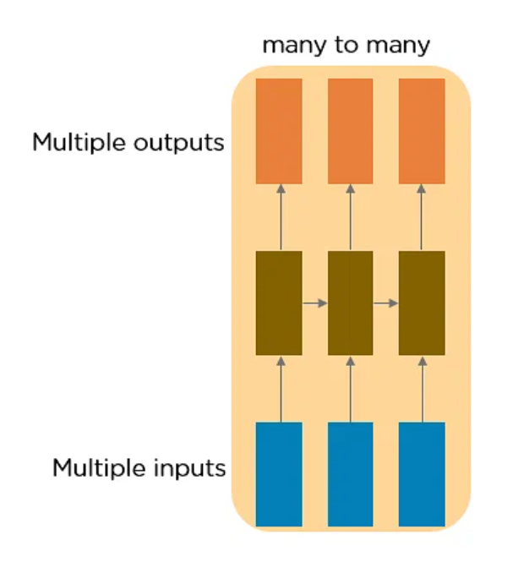
Many to Many
This RNN takes a sequence of inputs and generates a sequence of outputs.

Slide 18
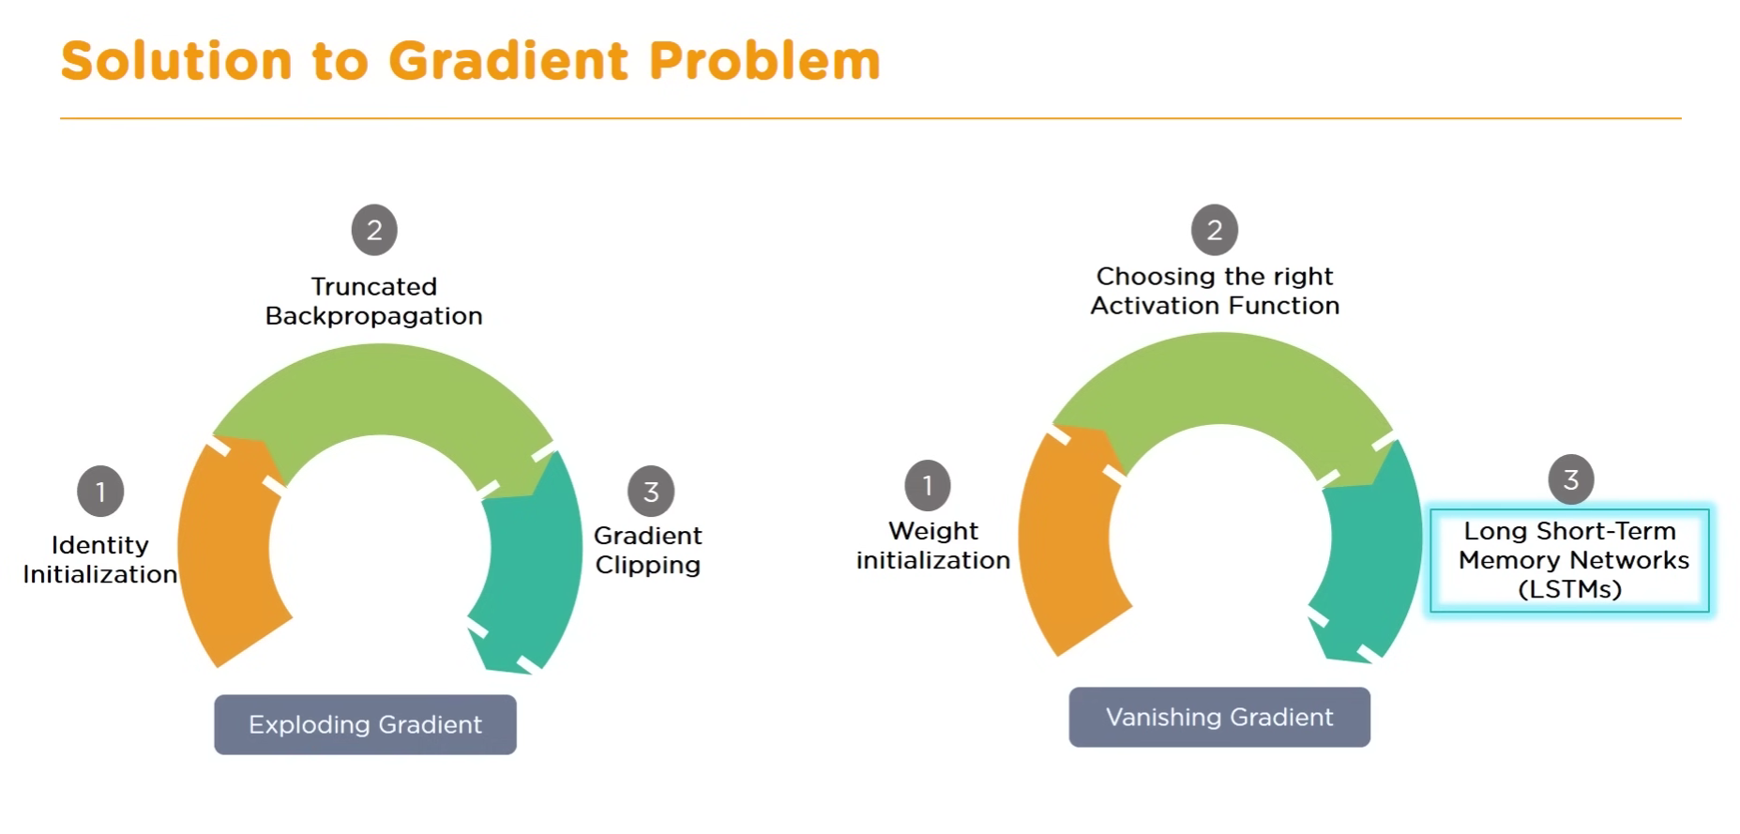

Slide 19
Identity initialization
Gradient descent with identity initialization efficiently learns positive definite linear transformations by deep residual networks.
Truncated Backpropagation Through Time (BPTT) offers the computational benefits of BPTT while eliminating the need for a complete retrace through the whole data sequence at each stage.
Gradient clipping ensures the gradient vector g has norm at most equal to threshold. This helps gradient descent to have reasonable behavior even if the loss landscape of the model is irregular, most likely a cliff.

Slide 20
Long Short-Term Memory (LSTM) Networks
Long Short-Term Memory (LSTM), introduced by Sepp Hochreiter and Jürgen Schmidhuber in 1997, is a type of recurrent neural network (RNN) architecture designed to handle long-term dependencies. The key innovation of LSTM lies in its ability to selectively store, update, and retrieve information over extended sequences, making it particularly well-suited for tasks involving sequential data.

Slide 21
Long Short-Term Memory (LSTM) Networks
LSTM is a type of RNN that is designed to handle the vanishing gradient problem that can occur in standard RNNs.
It does this by introducing three gating mechanisms that control the flow of information through the network: the input gate, the forget gate, and the output gate.
These gates allow the LSTM network to selectively remember or forget information from the input sequence, which makes it more effective for long-term dependencies.

Slide 22
LSTMs are a special kind of RNN — capable of learning long-term dependencies by remembering information for long periods is the default behavior.
All RNN are in the form of a chain of repeating modules of a neural network. In standard RNNs, this repeating module will have a very simple structure, such as a single tanh layer.
LSTMs also have a chain-like structure, but the repeating module is a bit different structure. Instead of having a single neural network layer, four interacting layers are communicating extraordinarily.

Slide 23
Memory cell is based on the Remembering and forgetting.
How do we remember ?
Based on the context of the Input.

Slide 24
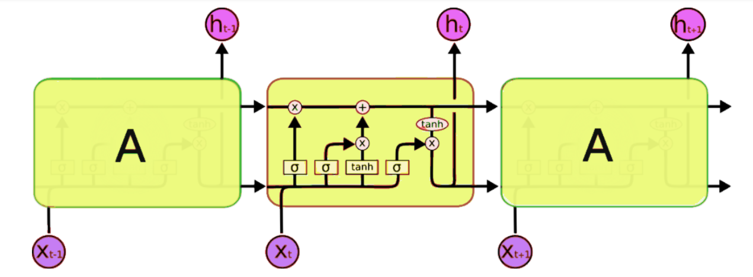
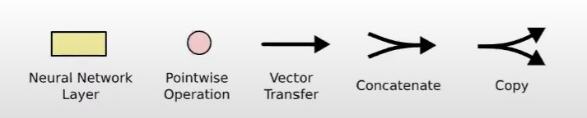

Slide 25
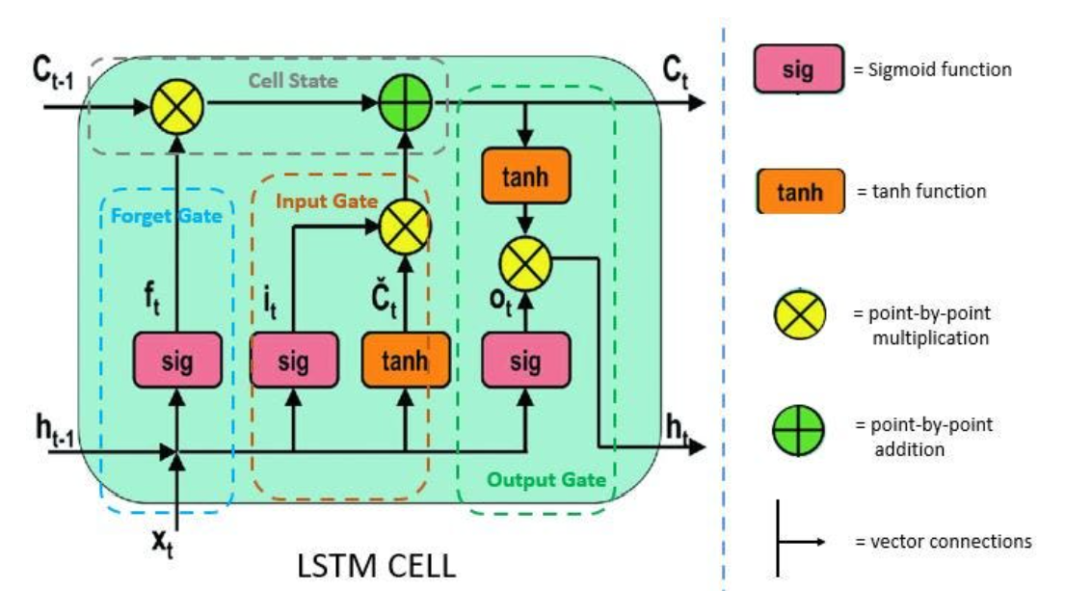

Slide 26
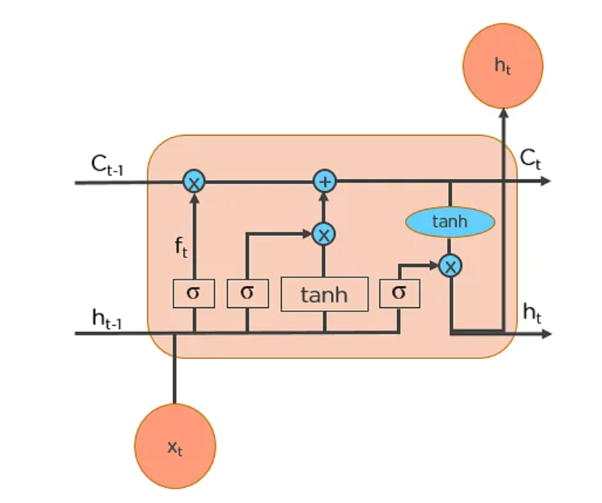

Slide 27
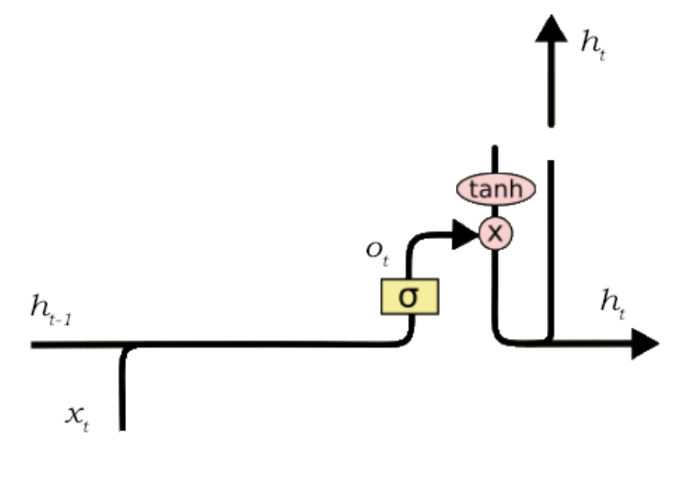
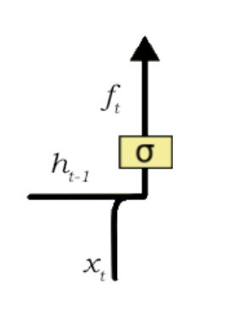
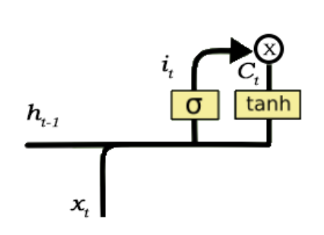

Slide 28
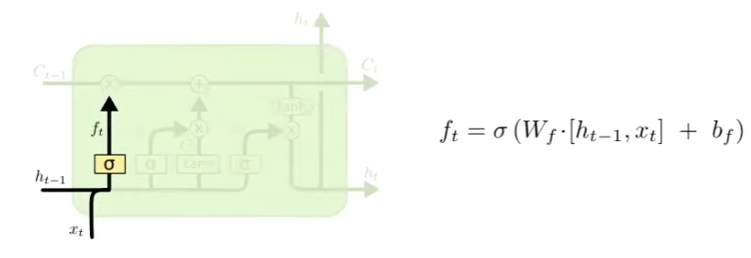
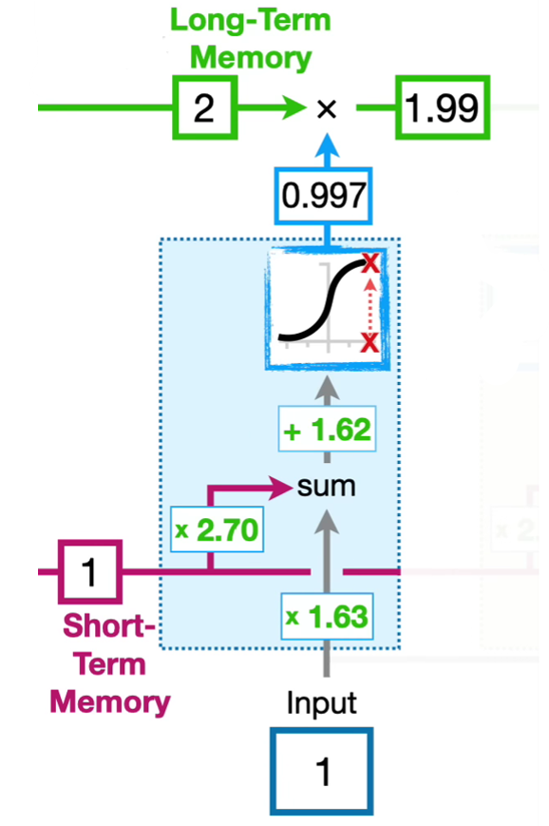
Combining two weights

Slide 29
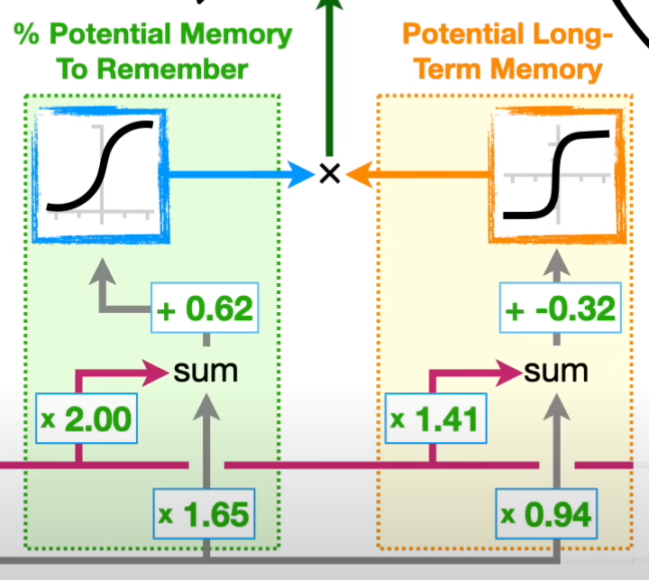
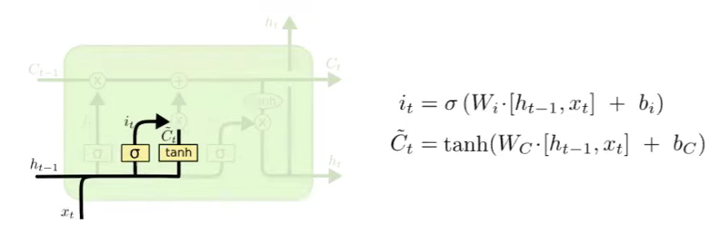
This stage is deciding how much percentage of Potential Memory need to be added to the LSTM.
Adding information to the memory cell

Slide 30
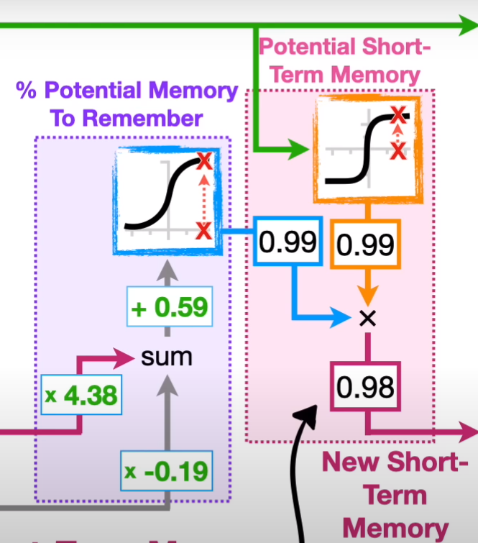
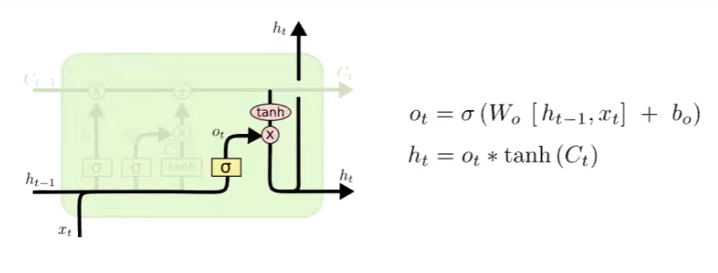
This Final stage updates the Short term Memory

Slide 31
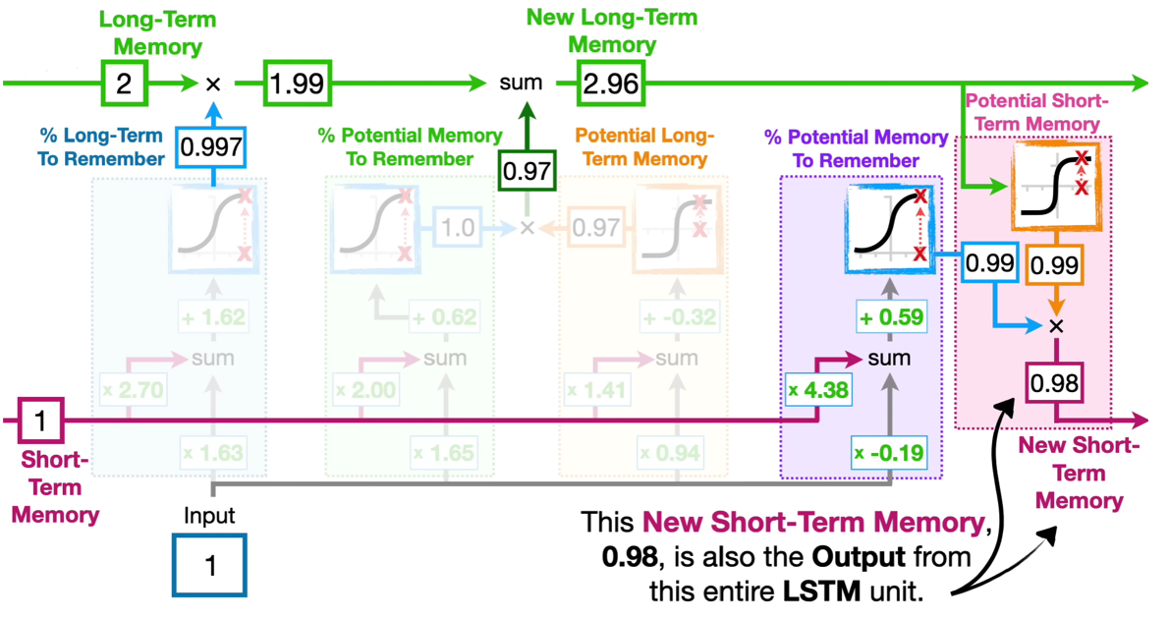

Slide 33
Step 1: Decide How Much Past Data It Should Remember
The first step in the LSTM is to decide which information should be omitted from the cell in that particular time step.
The sigmoid function determines this.
It looks at the previous state (ht-1) along with the current input xt and computes the function.

Slide 34
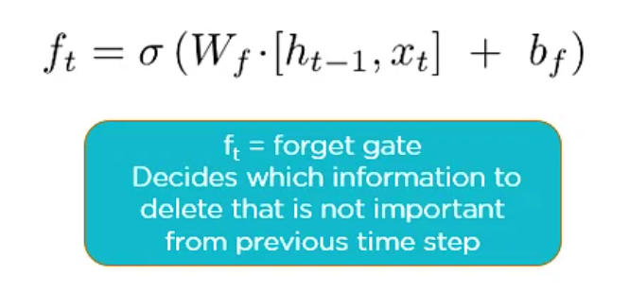

Slide 35
Step 2: Decide How Much This Unit Adds to the Current State
In the second layer, there are two parts. One is the sigmoid function, and the other is the tanh function.
In the sigmoid function, it decides which values to let through (0 or 1).
tanh function gives weightage to the values which are passed, deciding their level of importance (-1 to 1).

Slide 36
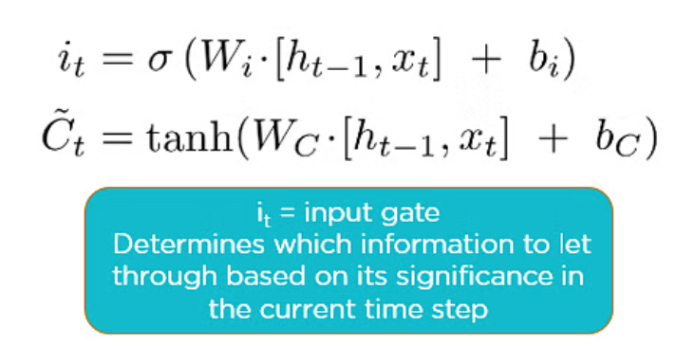

Slide 37
Step 3: Decide What Part of the Current Cell State Makes It to the Output
The third step is to decide what the output will be. First, we run a sigmoid layer, which decides what parts of the cell state make it to the output.
Then, put the cell state through tanh to push the values to be between -1 and 1 and multiply it by the output of the sigmoid gate.

Slide 38
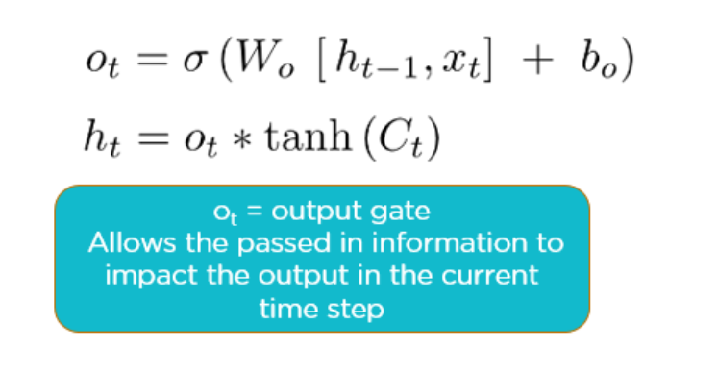

Slide 39
Advantages of LSTM
Long-term dependencies can be captured by LSTM networks. They have a memory cell that is capable of long-term information storage.
In traditional RNNs, there is a problem of vanishing and exploding gradients when models are trained over long sequences. By using a gating mechanism that selectively recalls or forgets information, LSTM networks deal with this problem.
LSTM enables the model to capture and remember the important context, even when there is a significant time gap between relevant events in the sequence. So where understanding context is important, LSTMS are used. eg. machine translation.

Slide 40
Disadvantages of LSTM
Compared to simpler architectures like feed-forward neural networks LSTM networks are computationally more expensive. This can limit their scalability for large-scale datasets or constrained environments.
Training LSTM networks can be more time-consuming compared to simpler models due to their computational complexity. So training LSTMs often requires more data and longer training times to achieve high performance.
Since it is processed word by word in a sequential manner, it is hard to parallelize the work of processing the sentences.

Slide 41
https://www.exxactcorp.com/blog/Deep-Learning/5-types-of-lstm-recurrent-neural-networks-and-what-to-do-with-them

Slide 42
https://colab.research.google.com/github/tensorflow/text/blob/master/docs/tutorials/text_classification_rnn.ipynb#scrollTo=9xvpE3BaGw_V

Slide 44
https://www.simplilearn.com/tutorials/deep-learning-tutorial/rnn

